Slide 1
Interactions of Requests to Physical Networks
An MDE Approach
By: Ismael Martinez

Slide 2
Motivation
Interaction of IoT with outside systems. e.g. Edge Network.
Current MDE solutions in IoT [1, 2] limit control to IoT domain. Interaction with outside systems are passive[1].
They require full specification and definition of IoT; this may not always be reasonable [1,2] (IoT experts and secondary system experts may be different).
Partially inspired by Environment DSL in IoT [2].
No concept of physical location of Things. Relative position between things were converted to global positions.
No concept of request scheduling in any implementation [1-4].
Modeling between migration simulators in IoT/Edge have no consistency – e.g. some allow mobility [5].
No MDE contributions for queueing systems.

Slide 3
Goal
Defines two DSLs to represent two systems; an actor (Things) and a receiver (Network).
Both DSLs need not be written by same domain experts; separation of concerns.
Integrate physical locations into both DSLs.
Implement of request scheduling of Things; defines behaviour.
Code Generation – Link both DSLs into Thing and Network instances.
Analysis – Perform simple request and structure metrics on Network, based on Things interaction.

Slide 4
Domain Specific Languages
Traffic Request Schedule (TRS) DSL – Defines the request behaviour of Things. Also defines the structure, i.e. position of Things.
Physical Network Structure (PNS) DSL – Defines the structure of a Network, including links between nodes.
Attributes are defined separately for each domain – Things, Nodes, Links.

Slide 5
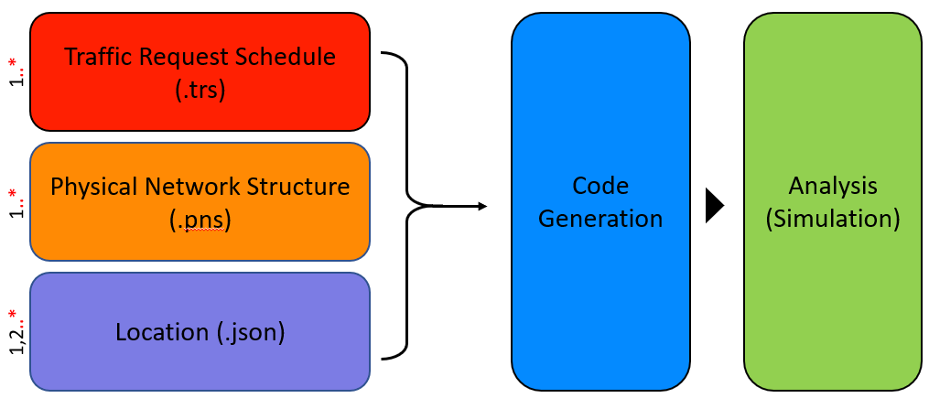
Solution

Slide 6

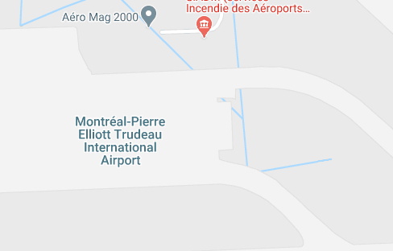


Physical Locations
Google Maps to display physical map, and get location data.
Javascript to aggregate location data and export to JSON.
Nodes Things
14
13
9
3
6
10
1
7
2
5
8
12
4
11

Slide 7





Python implementation
TextX – XtextX implementation in Python.
Define Grammars, Metamodels, and Model Parsing.
Code Generation uses TextX parser
Python + TextX to generate Python code.
CV2 and NetworkX library to visualize network structure.
Matplotlib to graph request assignment.

Slide 8
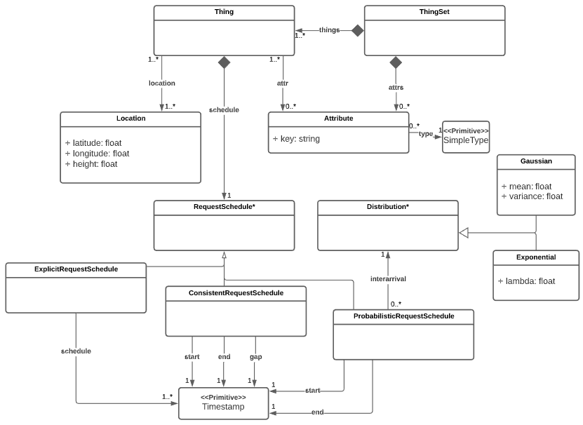
TRS Metamodel
Timestamp (2[0-3] | [01][0-9]): ([0-5][0-9])
(:[0-5][0-9](.[0-9}{3})? )?
e.g. ‘12:00’ ‘16:51:52’
‘05:28:16.873’
SimpleType
String | Float | Int | Bool | Timestamp

Slide 9
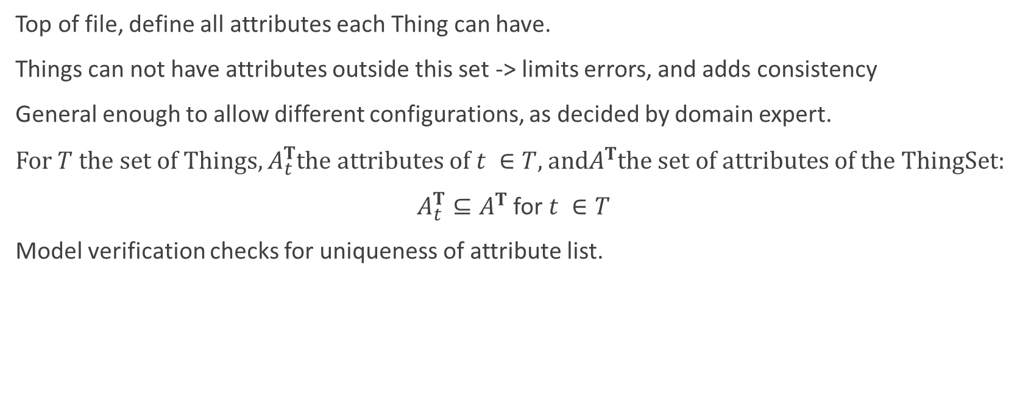
TRS – Attributes
Top of file, define all attributes each Thing can have.
Things can not have attributes outside this set -> limits errors, and adds consistency
General enough to allow different configurations, as decided by domain expert.
For $T$ the set of Things, $A_{t}^{T}$the attributes of $t ∈T$, and$A^{T}$the set of attributes of the ThingSet:
$A_{t}^{T}⊆A^{T}$ for $t ∈T$
Model verification checks for uniqueness of attribute list.
thing t3 {
… attributes { fileSize_mb:85 localCPU_ghz:4.6 localProcessing_ms: 32 memoryReq_mb:24 } }
Thing IoT
attributes { key: fileSize_mb, type: int key: localCPU_ghz, type: float key: localProcessing_ms, type: int key: memoryReq_mb, type: int key: storageReq_mb, type: int }

Slide 10
TRS – Request Schedule
Explicit – Define an array of timestamps
Consistent – Define an interval, and a frequency of requests
Probabilistic – Define an interval, and an interarrival distribution.
explicitRequestSchedule{ [12:00, 12:03, 13:21, 13:45, 14:29] }
consistentRequestSchedule { start: 12:12 end: 13:54 gap:00:15 }
probabilisticRequestSchedule { start:12:00 end: 13:00 interarrivalDistribution: Exponential(lambda=0.002) }

Slide 11
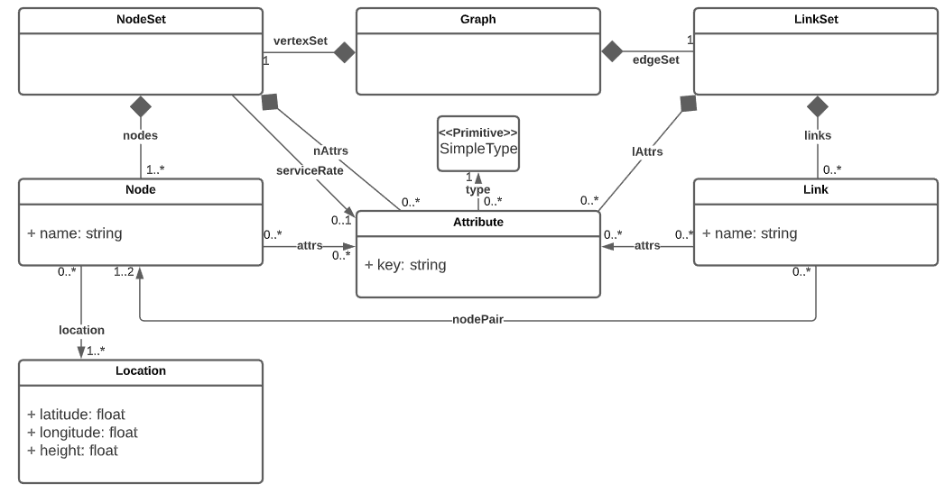
PNS Metamodel

Slide 12
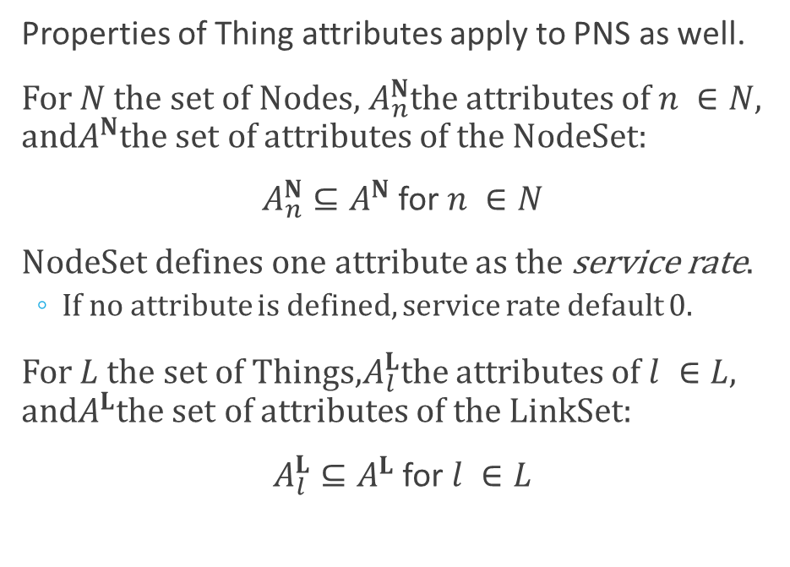
PNS – Attributes
Graph Edge
nodeSet { attributes { key: storage_mb, type: int key: cpu_ghz, type: float key: memory_mb, type: int }
serviceRate: cpu_ghz
…
}
linkSet { attributes { key: bandwidth, type: float }
…
}
Properties of Thing attributes apply to PNS as well.
For $N$ the set of Nodes, $A_{n}^{N}$the attributes of $n ∈N$, and$A^{N}$the set of attributes of the NodeSet:
$A_{n}^{N}⊆A^{N}$ for $n ∈N$
NodeSet defines one attribute as the service rate.
If no attribute is defined, service rate default 0.
For $L$ the set of Things,$A_{l}^{L}$the attributes of $l ∈L$, and$A^{L}$the set of attributes of the LinkSet:
$A_{l}^{L}⊆A^{L}$ for $l ∈L$

Slide 13

PNS – Node Pair
Required by link $l ∈L$. Reference to nodes.
nodeSet {
node n2 { … }
node n4 { … }
}
linkSet{
link l1 {
…
nodePair: (n2, n4)
}
}

Slide 14

PNS and TRS – Locations
Required by nodes $n ∈N$ and things $t ∈T$. Not links!
Links generated JSON of locations to PNS and TRS files.
Each node/thing can have multiple locations – mobility.
node n4 { attributes { … } location { [“1, 2"] } }
{ "location": { "1": { "latitude": "45.465664933903625", "longitude": "-73.7456826990701", "height": 1 }, "2": { "latitude": "45.46566563932783", "longitude": "-73.74562006549", "height": 1 }
…
}
thing t3 {
… attributes { …
}
location {
[“3”]
} }

Slide 15
Code Generation
Non-Generated Code
Abstract Classes
Utility Functions
Analysis Code
‘Request volume’ Graphs
Network Structure Graphs
Queue Simulation
Generated Code
Device and Attribute Classes
Instances
Additional Code
Use generated network structure

Slide 16
Code Generation
## Verify TRS file mm_trs = metamodel_from_file(trs_grammar) metamodel_export(mm_trs, 'TRS/trs.dot') os.system('dot -Tpng -O TRS/trs.dot') #os.system('dot -Tpng -O TRS/trs_grammar.dot') # Creates PNG of metamodel from Grammar try: trs_model = mm_trs.model_from_file(trs_file) # All attributes are unique unique_set = list(set(trs_model.attributes)) if len(trs_model.attributes) != len(unique_set): raise Exception("Things attributes must be unique: ThingSet {}.".format(trs_model.name)) # The attributes of each thing is unique for thing in trs_model.things: thing_unqiue_attr = list(set(thing.attributes)) if len(thing_unqiue_attr) != len(thing.attributes): raise Exception("Thing attribubte must be unqiue: Thing {}".format(thing.name)) except Exception as e: print('Verification Failed: Error in file {}'.format(trs_file)) print(e) exit() print('Verification of file {} succeeded.'.format(trs_file)) with open(trs_location_file) as loc: loc_data_trs = json.load(loc) trs_parser(trs_model, loc_data_trs['location'])
TextX!
TextX!
Verify TRS and PNS files.
Parse and link with JSON location files.

Slide 17
Code Generation
def generateThingAttributes(name, attributes): param_list = ', '.join(attributes) thing_attributes_class = 'class ThingAttributes_{}:\n\tdef __init__(self'.format(name) if len(param_list) > 0: thing_attributes_class += ', ' + param_list + '):\n' else: thing_attributes_class += '):\n' for attr in attributes: thing_attributes_class += '\t\tself.{} = {}\n'.format(attr, attr) attribute_list = ['"' + attr + '"' for attr in attributes] thing_attributes_class += '\tdef listAttributes(self):\n\t\treturn [{}]\n'.format(','.join(attribute_list)) return thing_attributes_class
def generateGraphClass(name): graph_class = 'class Graph_{}(GraphAbstract):\n'.format(name) graph_class += '\tdef __init__(self, id, nodes, links):\n' graph_class += '\t\tself.id= id\n' graph_class += '\t\tself.nodes = nodes\n\t\tself.links=links\n' graph_class += '\t\tself.paths = depthFirstSearch(self.nodes)\n' return graph_class
Generate classes for Things, Nodes and Links with specified attributes.

Slide 18
Code Generation
# Parse requestSchedule requestSchedule = thing.requestSchedule schedule_type =requestSchedule._tx_fqn if 'ConsistentRequestSchedule' in schedule_type: consistentMap = {} consistentMap['start'] = requestSchedule.start consistentMap['end'] = requestSchedule.end consistentMap['gap'] = requestSchedule.gap [schedule_sec, schedule_str] = consistentSchedule(consistentMap) elif 'ExplicitRequestSchedule' in schedule_type: explicitMap = {} explicitMap['schedule'] = requestSchedule.schedule schedule_str = requestSchedule.schedule[1:-1].split(',') scheule_sec = [timestamp.convert_to_seconds(s) for s in schedule_str] elif 'ProbabilisticRequestSchedule' in schedule_type: probMap = {} probMap['start'] = requestSchedule.start probMap['end'] = requestSchedule.end probMap['interarrivalDistribution'] = requestSchedule._tx_fqn if 'Exponential' in requestSchedule._tx_fqn: probMap['lambda'] = requestSchedule.lambda_mean elif 'Gaussian' in requestSchedule._tx_fqn: probMap['mu'] = requestSchedule.mu probMap['var'] = requestSchedule.var
Convert consistent and probabilistic schedules into explicit schedules.

Slide 19
Generated Code
Device and Attribute classes for Things, Nodes, Links and Graph = (N, L)
class Thing_IoT(ThingAbstract): def __init__(self,id, schedule, locations,attributes): self.id = id self.schedule = schedule self.locations = locations self.attributes = attributes
class ThingAttributes_IoT: def __init__(self, fileSize_mb, localCPU_ghz, localProcessing_ms, memoryReq_mb, storageReq_mb): self.fileSize_mb = fileSize_mb self.localCPU_ghz = localCPU_ghz self.localProcessing_ms = localProcessing_ms self.memoryReq_mb = memoryReq_mb self.storageReq_mb = storageReq_mb def listAttributes(self): return ["fileSize_mb","localCPU_ghz","localProcessing_ms","memoryReq_mb","storageReq_mb"]

Slide 20
Generated Code
Device and Attribute classes for Things, Nodes, Links and Graph = (N, L)
class Node_Edge(NodeAbstract): def __init__(self, id, locations, attributes): self.id = id self.locations=locations self.attributes= attributes def service_rate(self): return self.attributes.cpu_ghz
class NodeAttributes_Edge: def __init__(self, storage_mb, cpu_ghz, memory_mb): self.storage_mb = storage_mb self.cpu_ghz = cpu_ghz self.memory_mb = memory_mb def listAttributes(self): return ["storage_mb","cpu_ghz","memory_mb"]

Slide 21
Generated Code
Instances of Things, Nodes and Links.
## Thing instances ## things = {} locations = [] locations.append(Locations(45.465660936499575, -73.74569047347666, 1)) attributes = ThingAttributes_IoT(16,3.2,5,6,0) # schedule_str = ['12:12:00', '12:27:00', '12:42:00', '12:57:00', '13:12:00', '13:27:00', '13:42:00'] schedule = [timestamp(43920),timestamp(44820),timestamp(45720),timestamp(46620),timestamp(47520),
timestamp(48420),timestamp(49320)] things["t1"] = Thing_IoT("t1", schedule, locations, attributes)

Slide 22
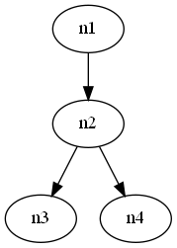
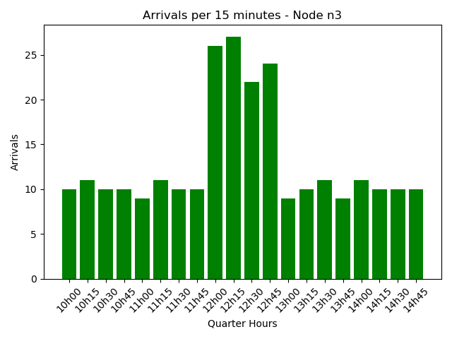
Analysis
Visualize the network structure.
Compute how many requests arrive at each node per hour or 15-minutes.
Compute queue simulation for Thing arrivals.
Thing->Node assignment is based on physical distance.
Arrival, Service, Wait, Departure
['11:57:05.065', 0.016747626303018234, 0.0, '11:57:05.081’]
['11:58:31.701', 0.023537211230500787, 0.0, '11:58:31.724’]
['11:59:59.900', 0.023629748998411394, 0.0, '11:59:59.923’]
['12:00:00.0', 0.014725786133364064, 0.0, '12:00:00.014’]
['12:00:00.0', 0.005775249368616292, 0.014725786131748464, '12:00:00.020’]
['12:00:00.078', 0.018694544639799044, 0.0, '12:00:00.096’]
['12:01:34.125', 0.030677970427223127, 0.0, '12:01:34.156’]
['12:01:49.040', 0.015338952811478252, 0.0, '12:01:49.055']

Slide 23
Demo
Map – Physical locations
Define attributes of DSL; reference locations
Code Generation
Analysis

Slide 24
Observations
Though this began as an IoT-Edge Network project, freedom of attributes allow for the modeling of any physical network with request schedules.
e.g. train station locations as Nodes, and historic passenger volumes as Things (location = suburbs/neighbourhoods).

Slide 25
Future Work
Integrate physical map application directly within PNS and TRS development.
Expand the types of interarrival distributions.
Allow code generation to pull multiple TRS and PNS files.
Expand queue simulation to use network structure, not just single node queues.
Improve visualization of network structures to include physical location over a map.
Expand and define mobility functionality of things and nodes. Expand simulation framework.
Integrate and test with other IoT DSLs (ThingML[1], MDE4IoT[4]).

Slide 26
References
[1] Harrand, N., Fleurey, F., Morin, B., & Husa, K. E. (2016, October). ThingML: a language and code generation framework for heterogeneous targets. In Proceedings of the ACM/IEEE 19th International Conference on Model Driven Engineering Languages and Systems (pp. 125-135).
[2] Doddapaneni, K., Ever, E., Gemikonakli, O., Malavolta, I., Mostarda, L., & Muccini, H. (2012, June). A model-driven engineering framework for architecting and analysing wireless sensor networks. In 2012 Third International Workshop on Software Engineering for Sensor Network Applications (SESENA) (pp. 1-7). IEEE.
[3] Thramboulidis, K., Bochalis, P., & Bouloumpasis, J. (2017, October). A framework for MDE of IoT-based manufacturing cyber-physical systems. In Proceedings of the seventh international conference on the internet of things (pp. 1-8).
[4] Ciccozzi, F., & Spalazzese, R. (2016, October). Mde4iot: supporting the internet of things with model-driven engineering. In International Symposium on Intelligent and Distributed Computing (pp. 67-76)
[5] Puliafito, C., Gonçalves, D. M., Lopes, M. M., Martins, L. L., Madeira, E., Mingozzi, E., ... & Bittencourt, L. F. (2020). MobFogSim: Simulation of mobility and migration for fog computing. Simulation Modelling Practice and Theory, 101, 102062.

